Slide 1
DEPLOYING A WEB APPLICATION USING AZURE APP SERVICE
Team Members:
Thakur Jatin Pratap Singh
Tadepally sudheekhsha
Singireddy Harish Reddy
Masapathri Jagadeshwar

Slide 2
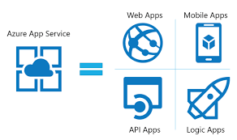
Why Azure App Service?
Azure App Service is a comprehensive, managed platform designed for the creation, deployment, and scaling of web applications.
It accommodates various programming languages and frameworks, such as .NET, Java, Node.js, and Python.
This service streamlines the deployment process and includes integrated DevOps capabilities.

Slide 3
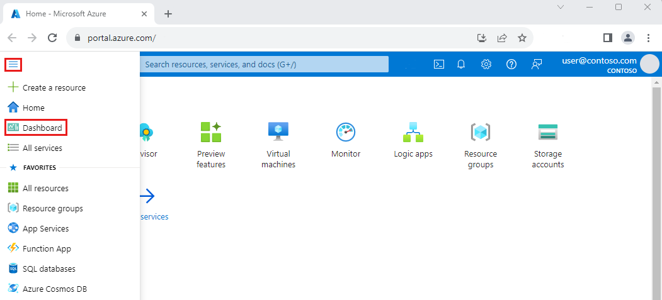
Prerequisites for Deployment
You need an active Azure subscription to get started with Azure App Service. Familiarity with the programming language and framework of your web application is essential. Ensure you have the necessary tools for deployment, such as Visual Studio, Azure CLI, or Git.

Slide 4
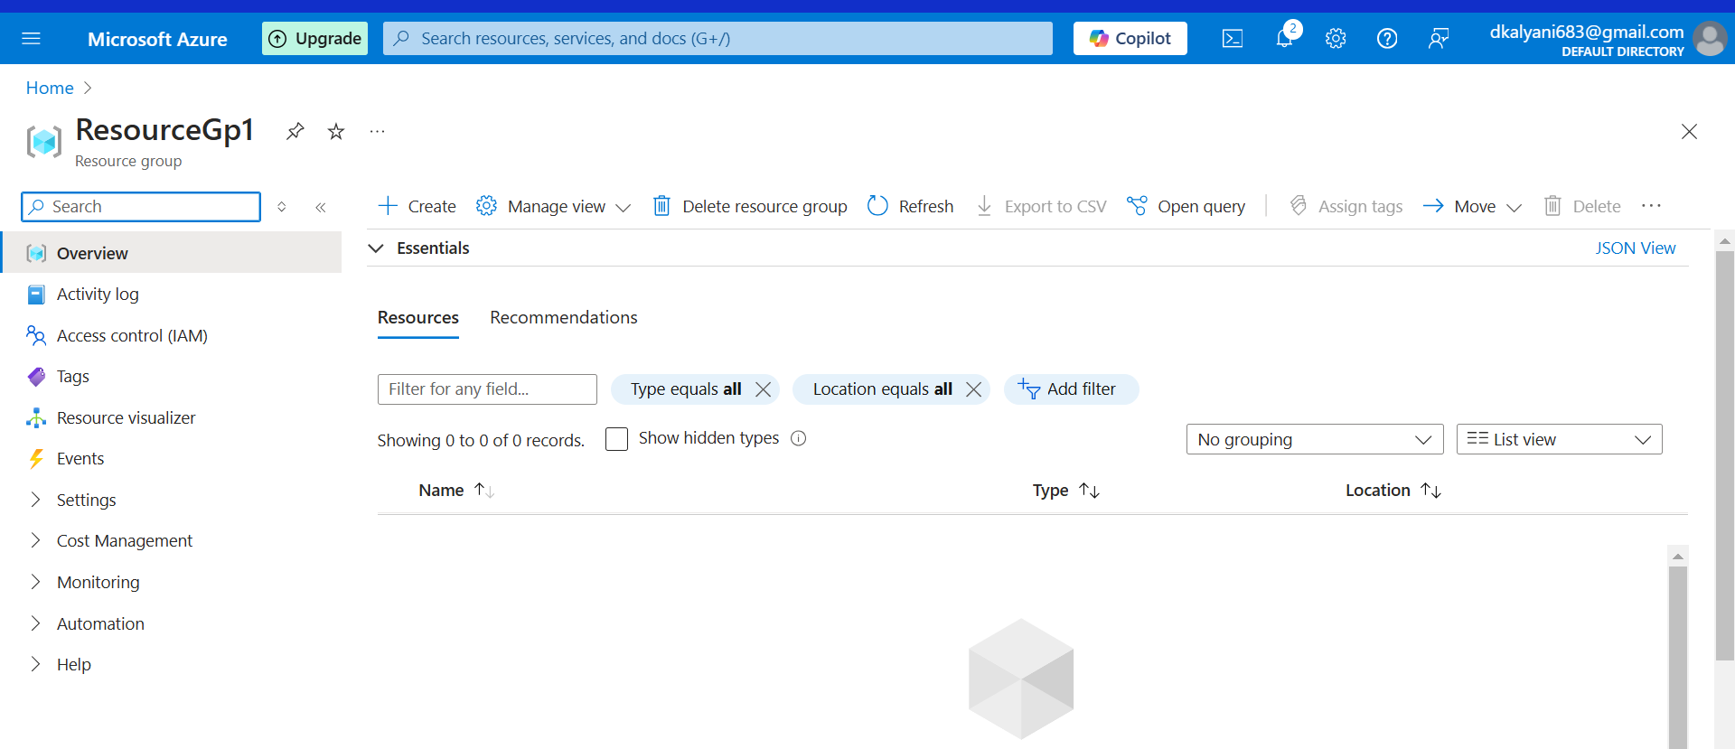
Login to Azure Portal:
Go to Azure Portal.
Log in with your Azure credentials.
Create a Resource Group

Slide 5
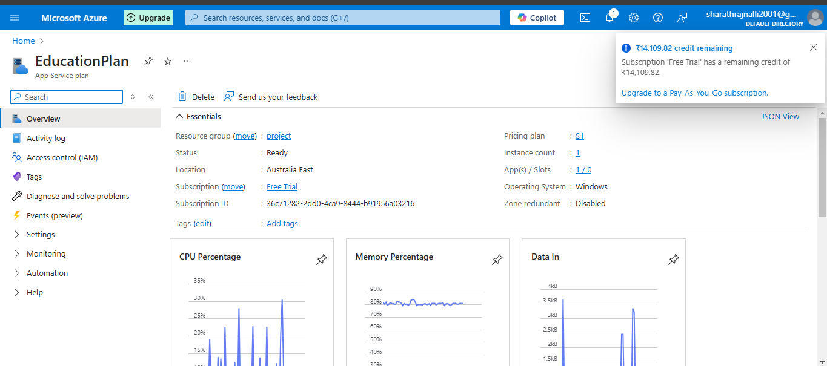
Created App Service Plan

Slide 6
Create an App Service :
Navigate to “Create a Resource” > Search for “App Service”.
Click on “Create”.
Fill in details:
Resource Group: Select or create a new one.
App Name: Enter a unique name for your app.
Runtime Stack: Choose the technology stack (e.g., .NET Core, Node.js).
Region: Select the appropriate region.
App Service Plan: Create a new one or select an existing plan.
Click “Review + Create” and then “Create”.

Slide 7
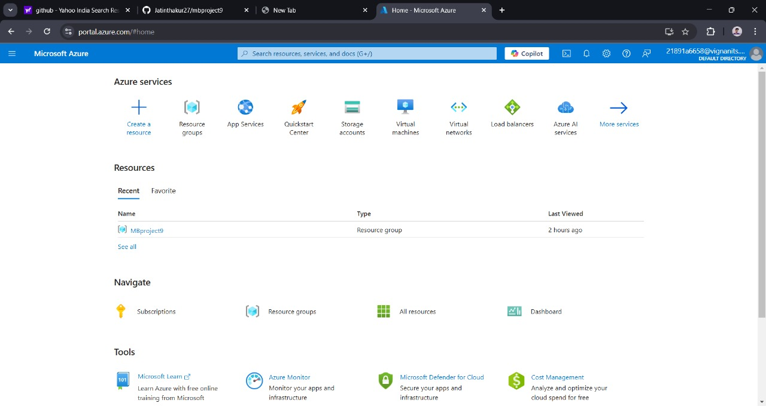
Resource Group is Created with name “MBproject9”

Slide 8
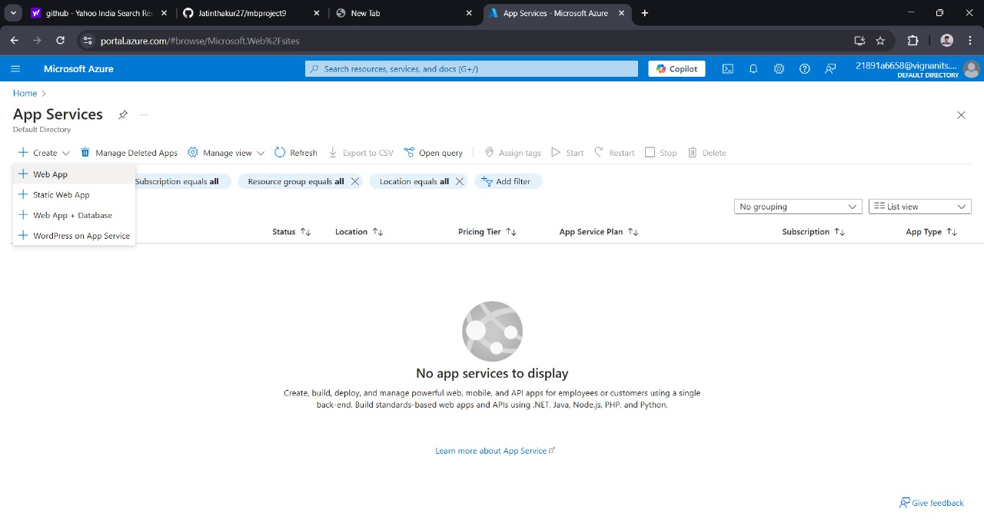
In the Azure portal , Navigate to your App Services
Click on “Create “ to create a Web service

Slide 9
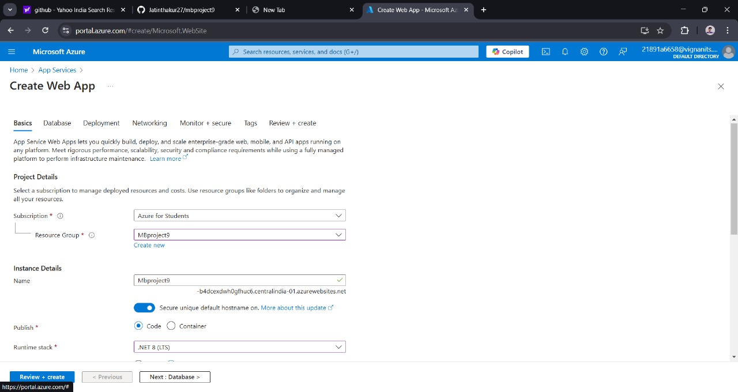
The user is at the "Basics" tab and has the option to proceed to the next configuration steps, such as database, deployment, networking, etc., before finalizing and creating the web app.

Slide 10
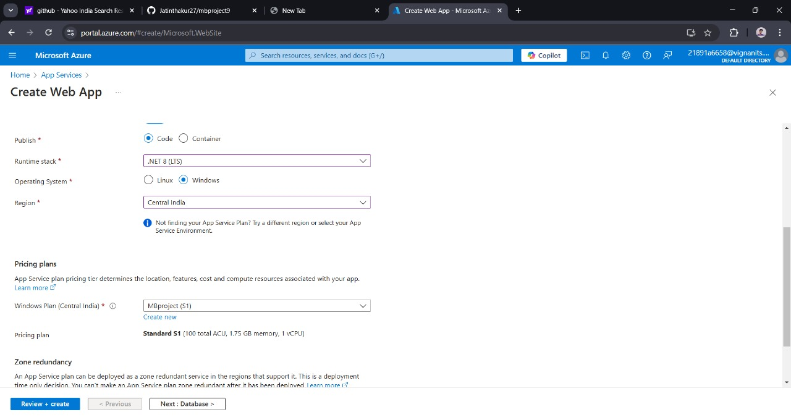
Choose a Runtime Stack and required Appropriate Region for the web app

Slide 11
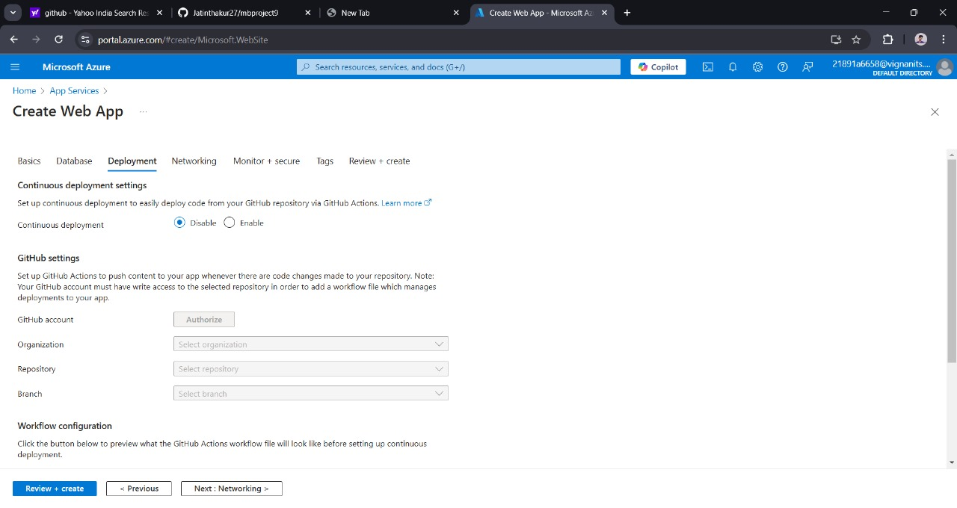

Provide the required Deployement and Networking settings for the Web application

Slide 12
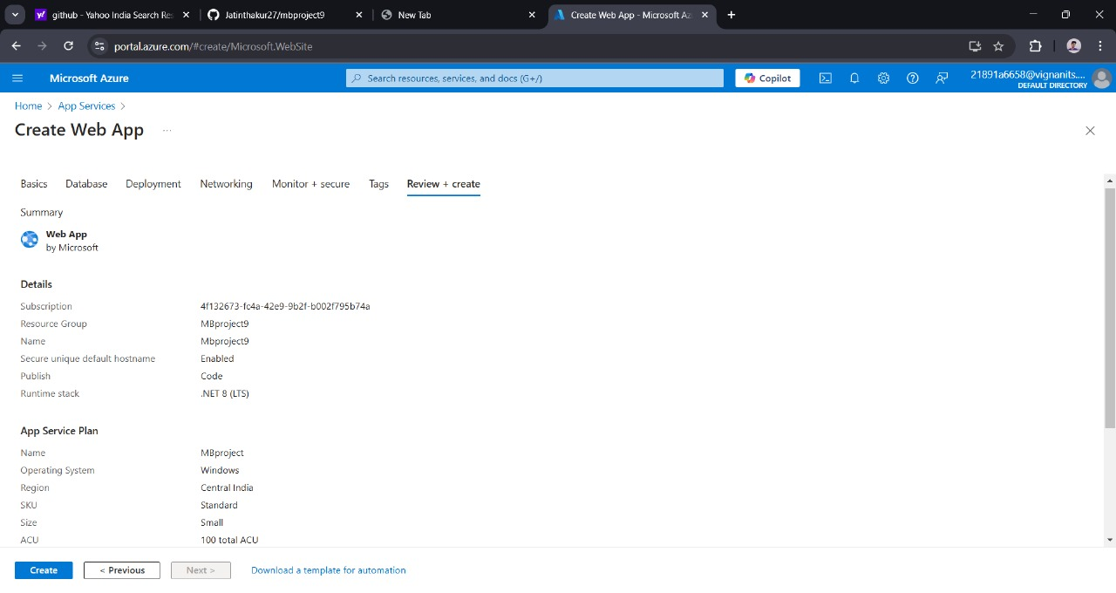
Finally click on Review + Create to check all the details and confirm to create the Web Application

Slide 13
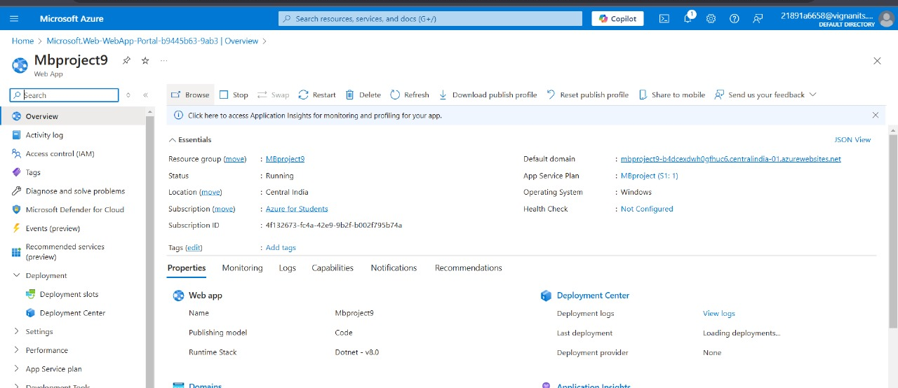
Successfully created the App Service in Azure portal.

Slide 14
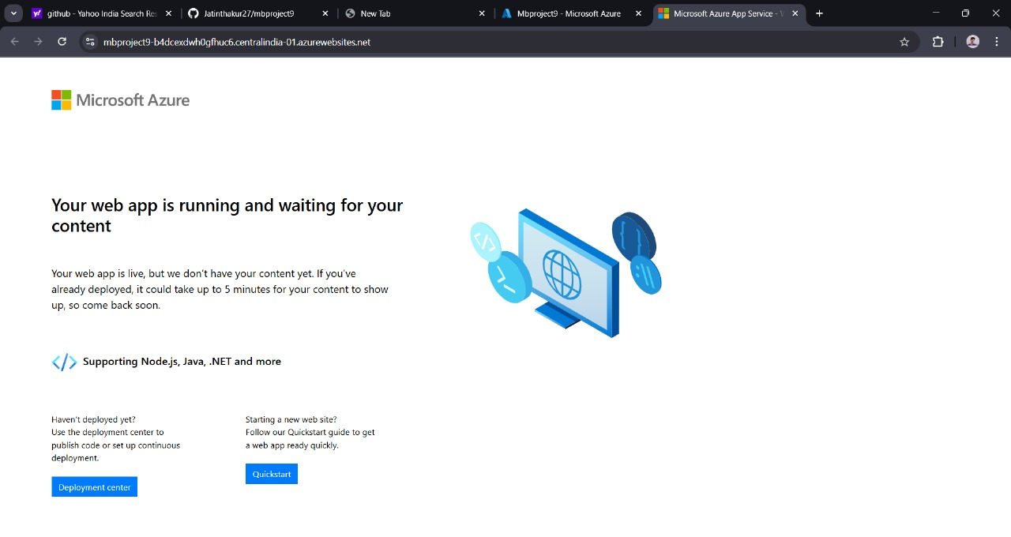
The Web application is Successfully Created and running .
Deploy the Content to the Application to complete the Web app.

Slide 15
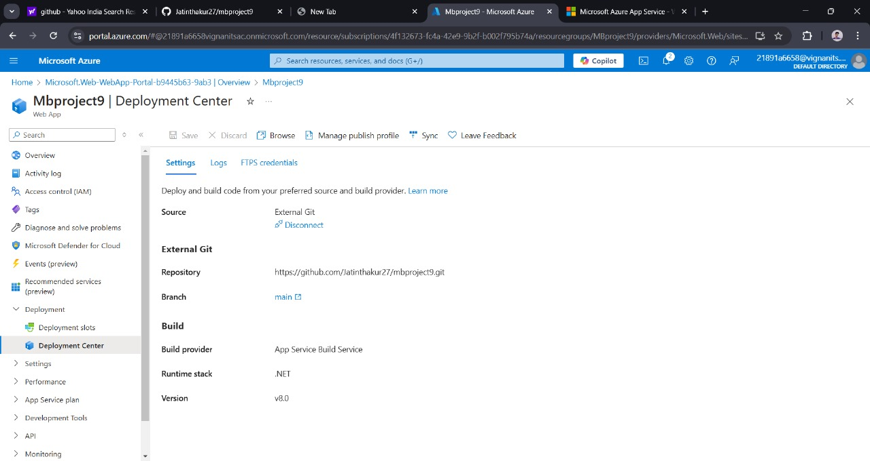
In the Web services ,Go to the Deployement Centre and provide required settings
for the deployment

Slide 16
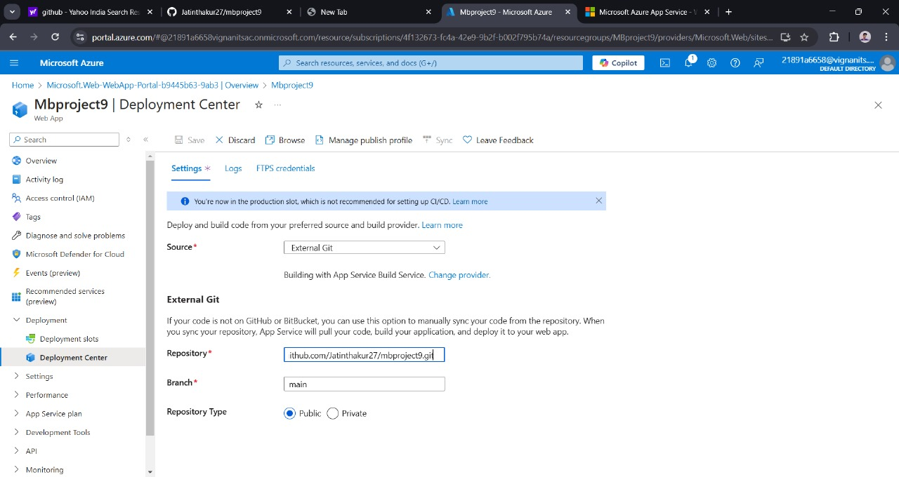
Go to the deployment Centre and provide the Source and Repository of the Git

Slide 17
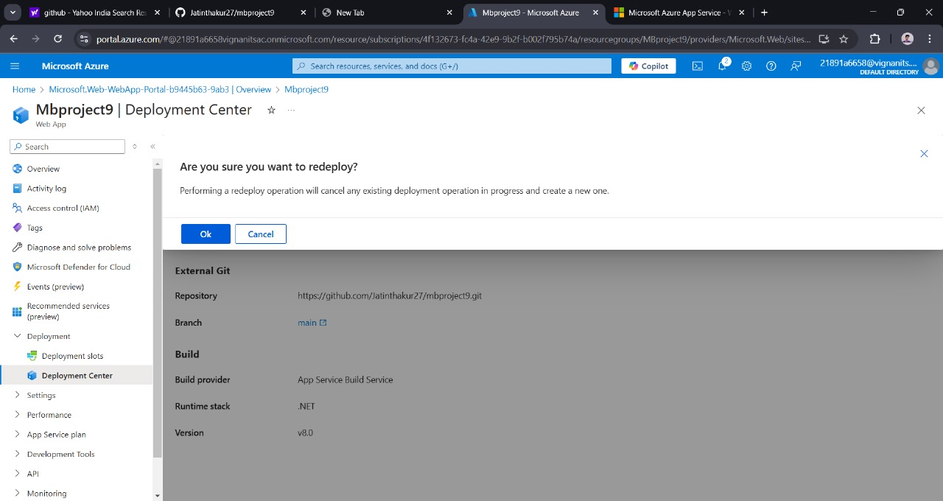
Make Sure all the details are correct before deploying the application.

Slide 18
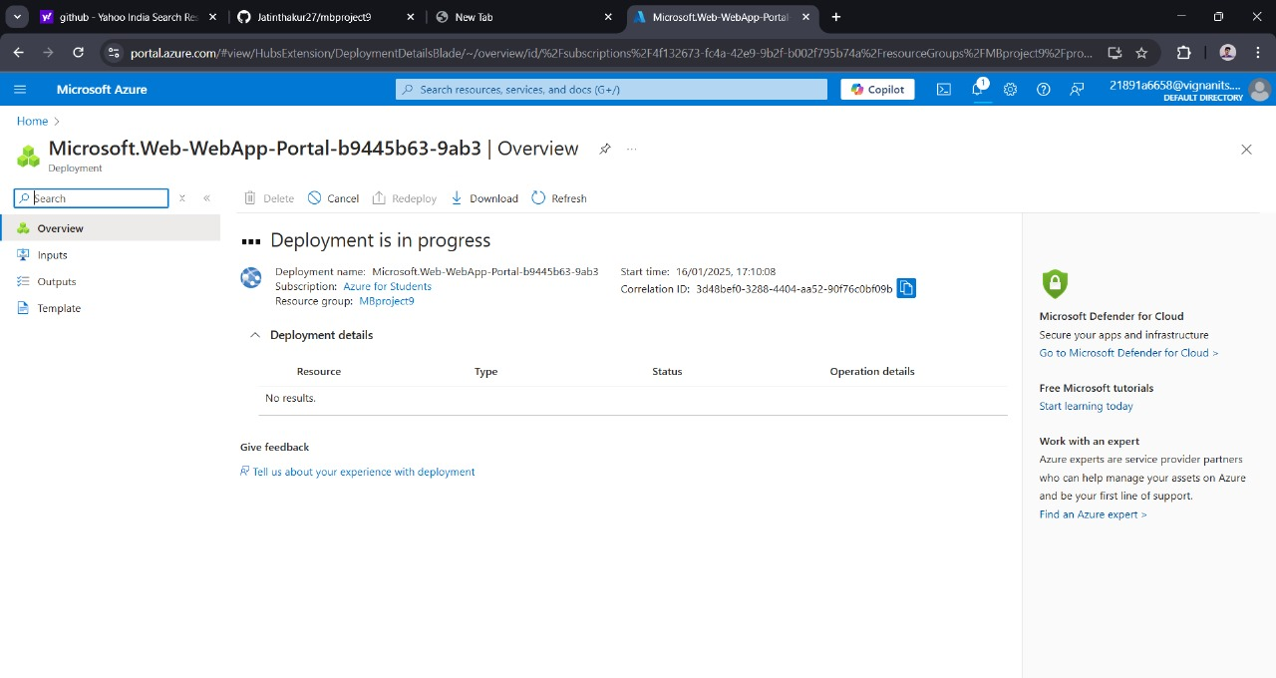
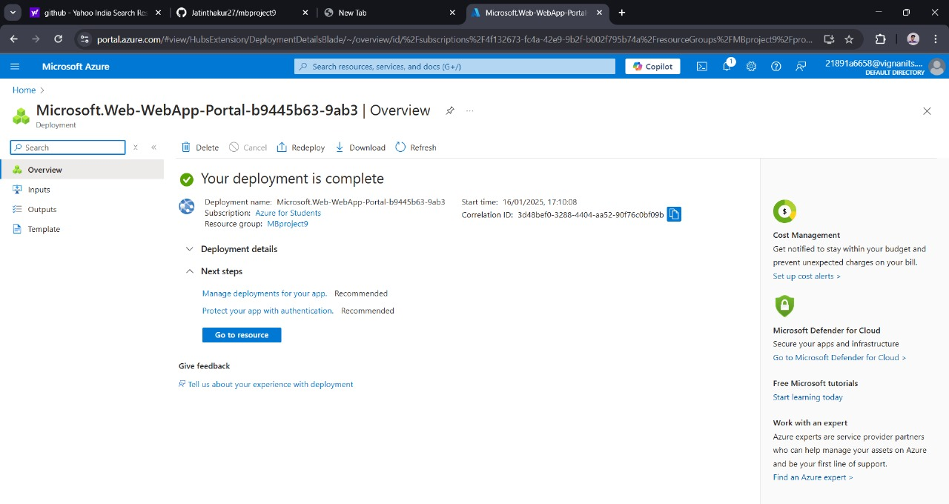
Check the progress on Deployment in the overview.
Here we can see the Deployment is complete.

Slide 19

To check the deployed application, open App Service Overview, Click on Browse in the right panel, Below page will appear.

Slide 20
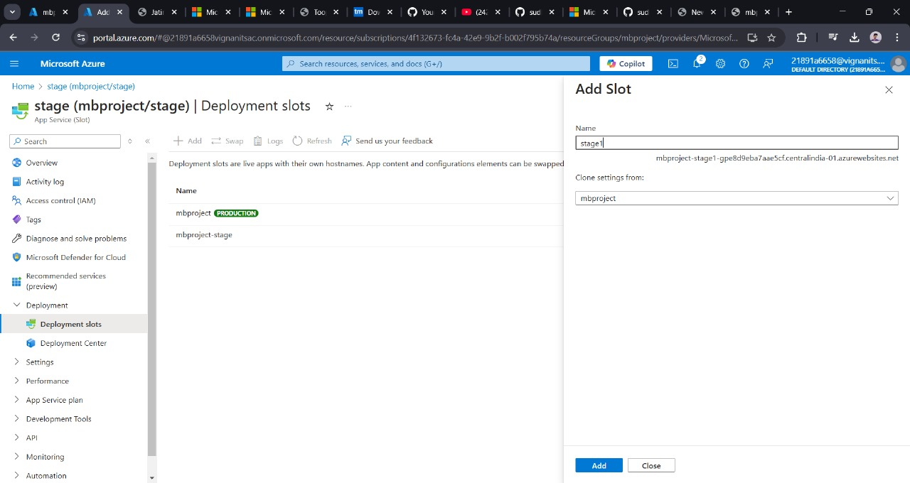
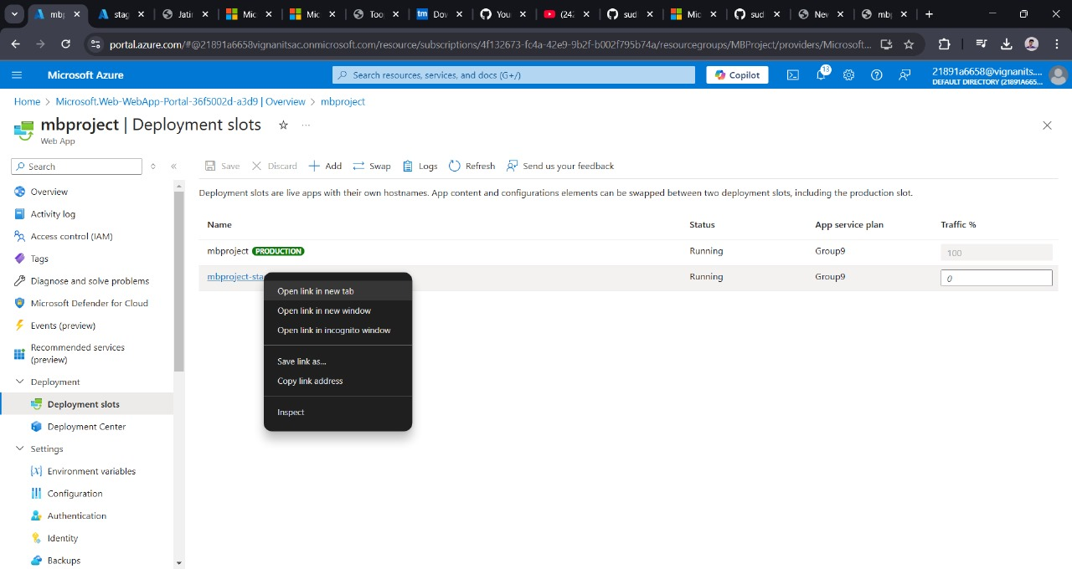
Creating Deployment slots makes it easy to make changes in our web applications dynamically .
We create deployment slot with a suitable name.
Now we copy the slot and open in new window.

Slide 21
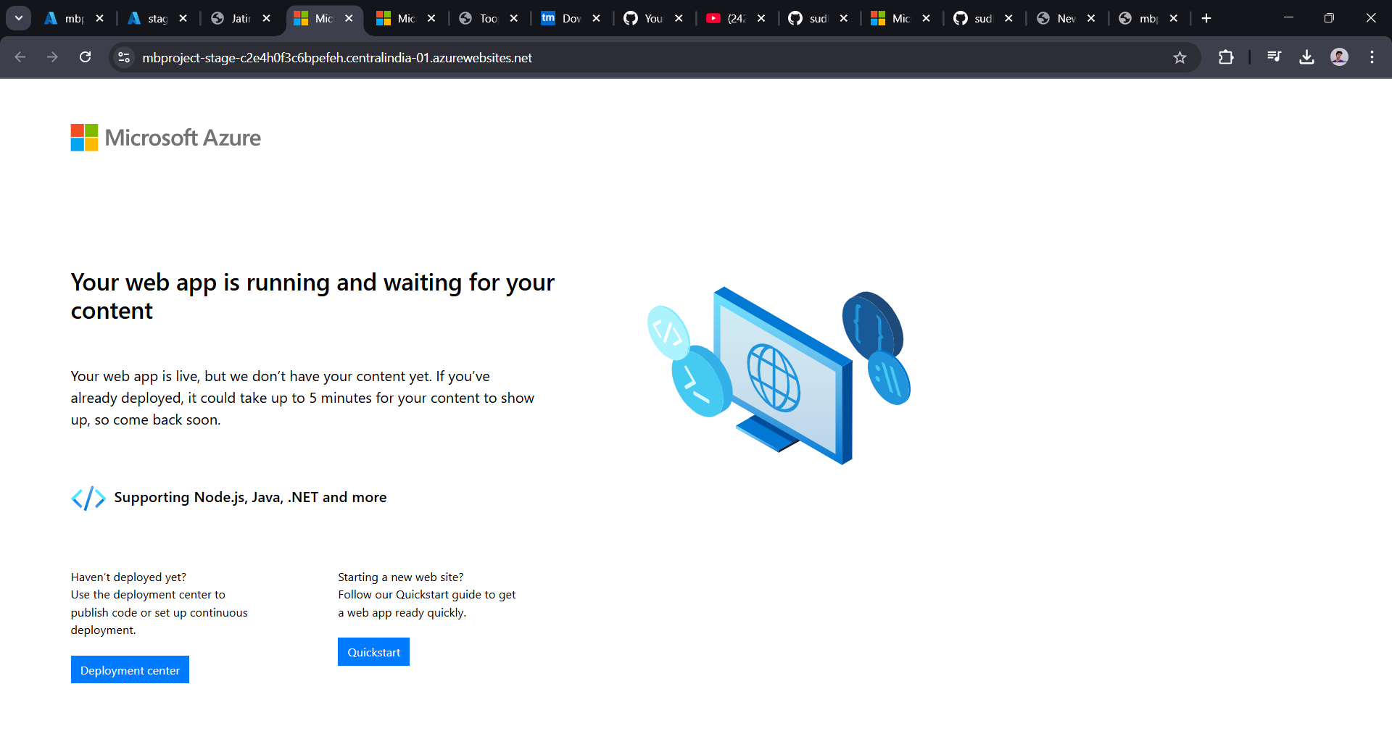
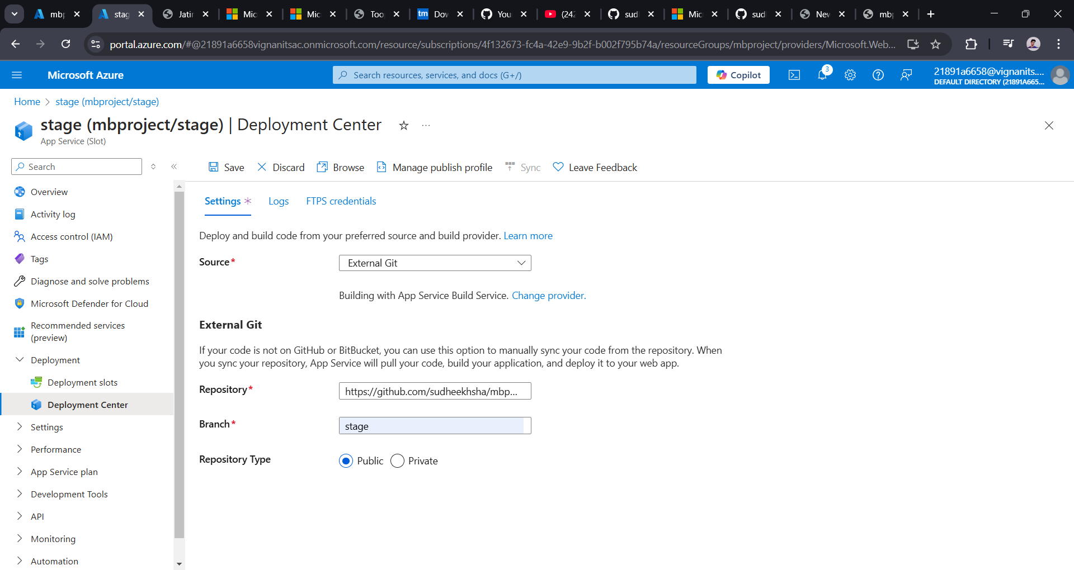
Now we go to deployment center and open our repository with the new branch where changes have been made

Slide 22
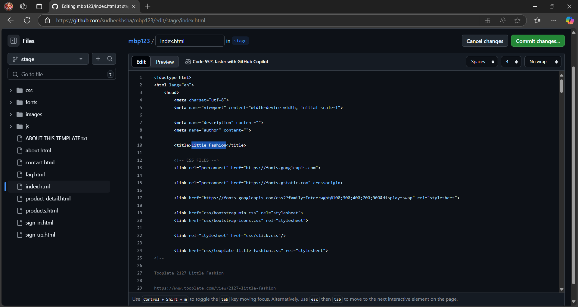
After creating a new branch ,we can go to the desired document and do required changes.
For instance ,we are changing the title of the web page here.

Slide 23

The changes have been made to the code

Slide 24
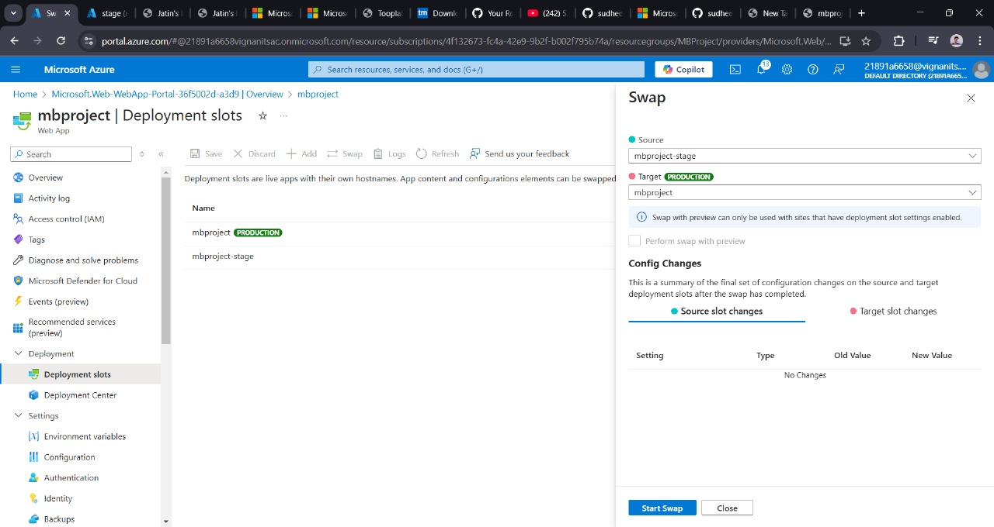
After making the changes ,We swap the deployment slot from production to stage to check the updated changes made to the application

Slide 25
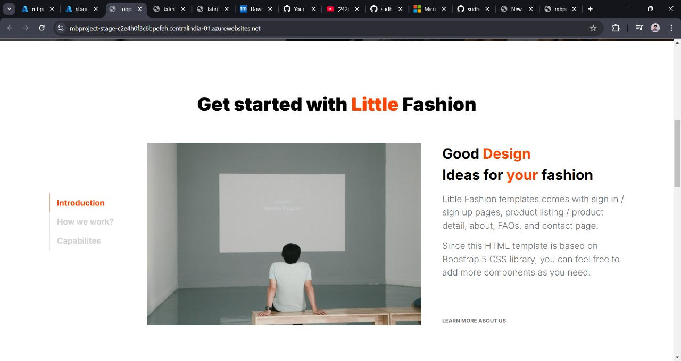
This is the page before the changes have been made

Slide 26
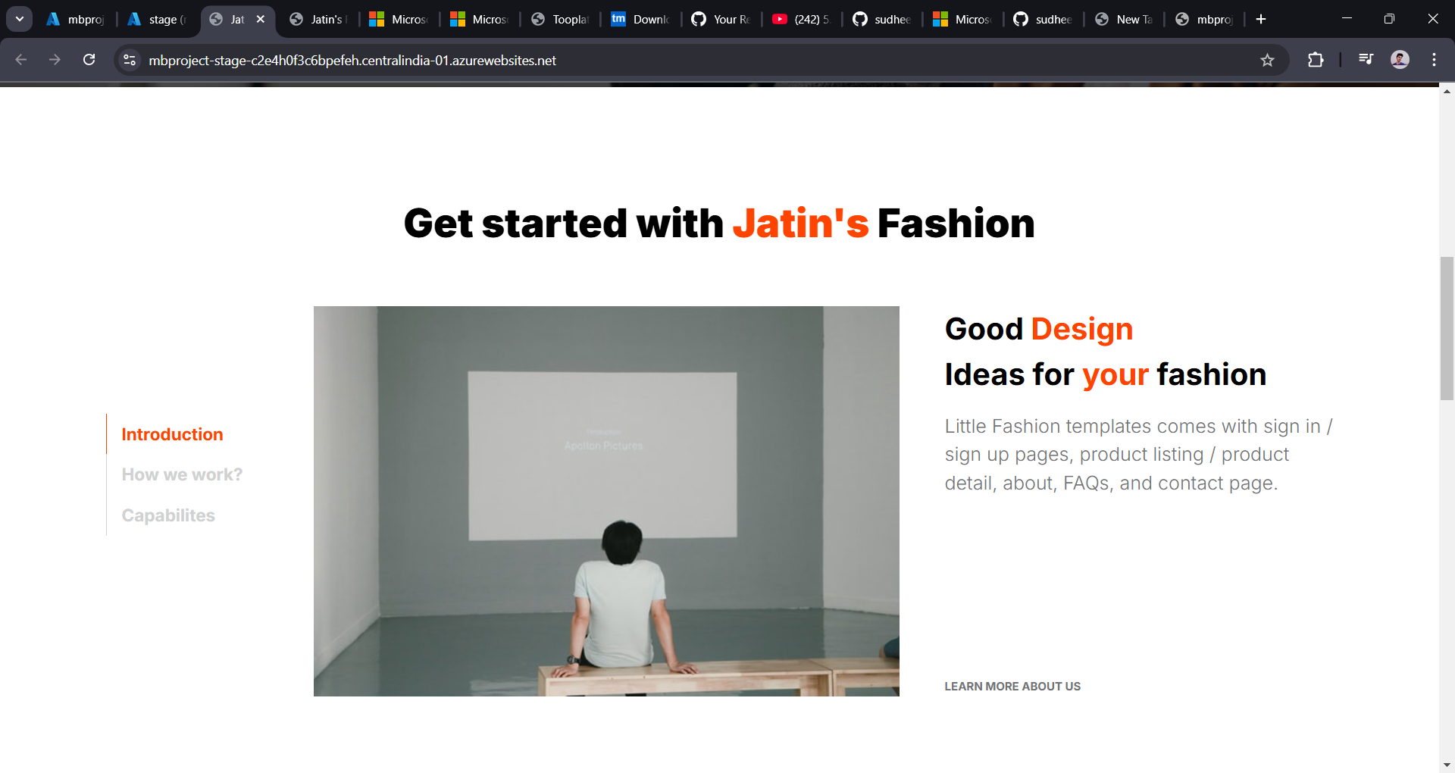
This is the page before the changes have been made

Slide 27

Conclusion
Azure App Service simplifies web app deployment and management.
Offers scalability, monitoring, and ease of integration with other Azure services.

Slide 28
THANK YOU

